Slide 1


Project Presentation (Summer Internship at NIT-AP)
Name : Mudhurakola Sahithi
University : Central University of Karnataka

Slide 2
Project Title :Stock Market Value Prediction
Purpose
With the advent of the digital computer, stock market prediction has since moved into the technological realm. The most prominent technique involves the use of artificial neural networks (ANNs) . ANNs can be thought of as mathematical function approximators. NNs require training and can have a large parameter space; it is useful to optimize the network for optimal predictive ability
In this project I will show you how to write a python program that predicts the price of stocks using a machine learning technique called Long Short-Term Memory (LSTM). This program is really simple and I doubt any major profit will be made from this program, but it’s slightly better than guessing! Remember the stock price can be affected by many different things.
Long short-term memory (LSTM) is an artificial recurrent neural network (RNN) architecture used in the field of deep learning. Unlike standard feed forward neural networks, LSTM has feedback connections. It can not only process single data points (such as images), but also entire sequences of data (such as speech or video).

Slide 3
Start Programming:
I will start by stating what I want this program to do. I want this program to predict the prices of Apple Inc. stock 60 days in the future based off of the current Close price.
First I will write a description about the program.
# Description: This program uses an artificial recurrent neural network called Long Short Term Memory (LSTM) to predict the closing stock price of a corporation (Apple Inc.) using the past 60 day stock price.Next I will load / import the libraries that will be used throughout this program.
#Import the libraries import math import pandas_datareader as web import numpy as np import pandas as pd from sklearn.preprocessing import MinMaxScaler from keras.models import Sequential from keras.layers import Dense, LSTM import matplotlib.pyplot as plt plt.style.use('fivethirtyeight')I will get the stock quote for the company ‘Apple Inc.’ using the companies stock ticker (AAPL) from January 1st, 2012 to December 17th, 2019.

Slide 4
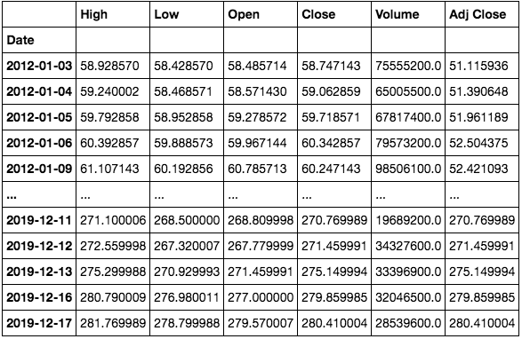
#Get the stock quote df = web.DataReader('AAPL', data_source='yahoo', start='2012-01-01', end='2019-12-17') #Show the data df

Slide 5
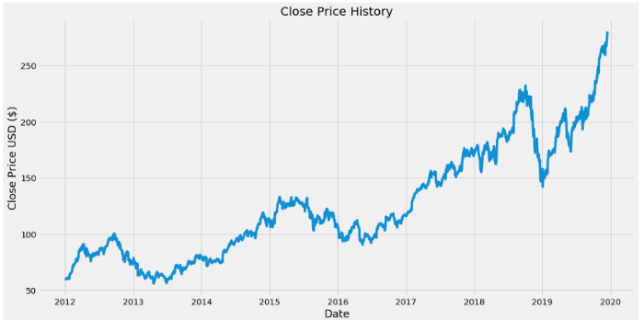
#Visualize the closing price history plt.figure(figsize=(16,8)) plt.title('Close Price History') plt.plot(df['Close']) plt.xlabel('Date',fontsize=18) plt.ylabel('Close Price USD ($)',fontsize=18) plt.show()

Slide 6
#Create a new dataframe with only the 'Close' column data = df.filter(['Close'])#Converting the dataframe to a numpy array dataset = data.values#Get /Compute the number of rows to train the model on training_data_len = math.ceil( len(dataset) *.8)
#Scale the all of the data to be values between 0 and 1 scaler = MinMaxScaler(feature_range=(0, 1)) scaled_data = scaler.fit_transform(dataset)
#Create the scaled training data set train_data = scaled_data[0:training_data_len , : ]#Split the data into x_train and y_train data sets x_train=[] y_train = [] for i in range(60,len(train_data)): x_train.append(train_data[i-60:i,0]) y_train.append(train_data[i,0])

Slide 7
#Convert x_train and y_train to numpy arrays x_train, y_train = np.array(x_train), np.array(y_train)Reshape the data to be 3-dimensional in the form [number of samples, number of time steps, and number of features]. The LSTM model is expecting a 3-dimensional data set.
#Reshape the data into the shape accepted by the LSTM x_train = np.reshape(x_train, (x_train.shape[0],x_train.shape[1],1))
model = Sequential() model.add(LSTM(units=50, return_sequences=True,input_shape=(x_train.shape[1],1))) model.add(LSTM(units=50, return_sequences=False)) model.add(Dense(units=25)) model.add(Dense(units=1))

Slide 8
#Compile the model model.compile(optimizer='adam', loss='mean_squared_error')Train the model using the training data sets. Note, fit is another name for train. Batch size is the total number of training examples present in a single batch, and epoch is the number of iterations when an entire data set is passed forward and backward through the neural network.
#Train the model model.fit(x_train, y_train, batch_size=1, epochs=1)
#Test data set test_data = scaled_data[training_data_len - 60: , : ]#Create the x_test and y_test data sets x_test = [] y_test = dataset[training_data_len : , : ] #Get all of the rows from index 1603 to the rest and all of the columns (in this case it's only column 'Close'), so 2003 - 1603 = 400 rows of data for i in range(60,len(test_data)): x_test.append(test_data[i-60:i,0])

Slide 9
#Convert x_test to a numpy array x_test = np.array(x_test)Reshape the data to be 3-dimensional in the form [number of samples, number of time steps, and number of features]. This needs to be done, because the LSTM model is expecting a 3-dimensional data set.
#Reshape the data into the shape accepted by the LSTM x_test = np.reshape(x_test, (x_test.shape[0],x_test.shape[1],1))Now get the predicted values from the model using the test data.
#Getting the models predicted price values predictions = model.predict(x_test) predictions = scaler.inverse_transform(predictions)#Undo scaling

Slide 10
#Calculate/Get the value of RMSE rmse=np.sqrt(np.mean(((predictions- y_test)**2))) rmse
#Plot/Create the data for the graph train = data[:training_data_len] valid = data[training_data_len:] valid['Predictions'] = predictions#Visualize the data plt.figure(figsize=(16,8)) plt.title('Model') plt.xlabel('Date', fontsize=18) plt.ylabel('Close Price USD ($)', fontsize=18) plt.plot(train['Close']) plt.plot(valid[['Close', 'Predictions']]) plt.legend(['Train', 'Val', 'Predictions'], loc='lower right') plt.show()

Slide 11
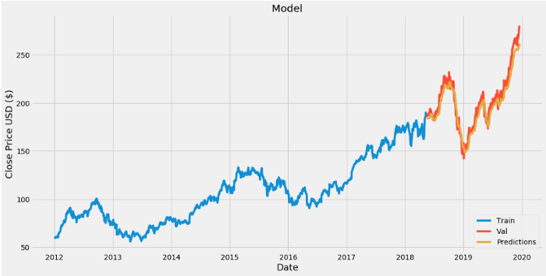
Actual Vs predicted values Comparition

Slide 12
apple_quote = web.DataReader('AAPL', data_source='yahoo', start='2012-01-01', end='2019-12-17')#Create a new dataframe new_df = apple_quote.filter(['Close'])#Get teh last 60 day closing price last_60_days = new_df[-60:].values#Scale the data to be values between 0 and 1 last_60_days_scaled = scaler.transform(last_60_days)#Create an empty list X_test = []#Append teh past 60 days X_test.append(last_60_days_scaled)#Convert the X_test data set to a numpy array X_test = np.array(X_test)#Reshape the data X_test = np.reshape(X_test, (X_test.shape[0], X_test.shape[1], 1))#Get the predicted scaled price pred_price = model.predict(X_test)#undo the scaling pred_price = scaler.inverse_transform(pred_price) print(pred_price)
The predicted price for 12/18/2019Now let’s see what the actual price for that day was.

Slide 13
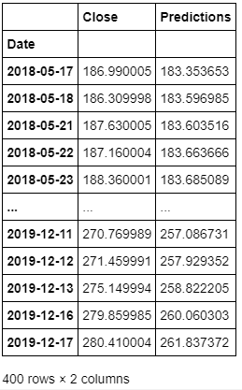
#Show the valid and predicted prices valid

Slide 14


